Slide 1
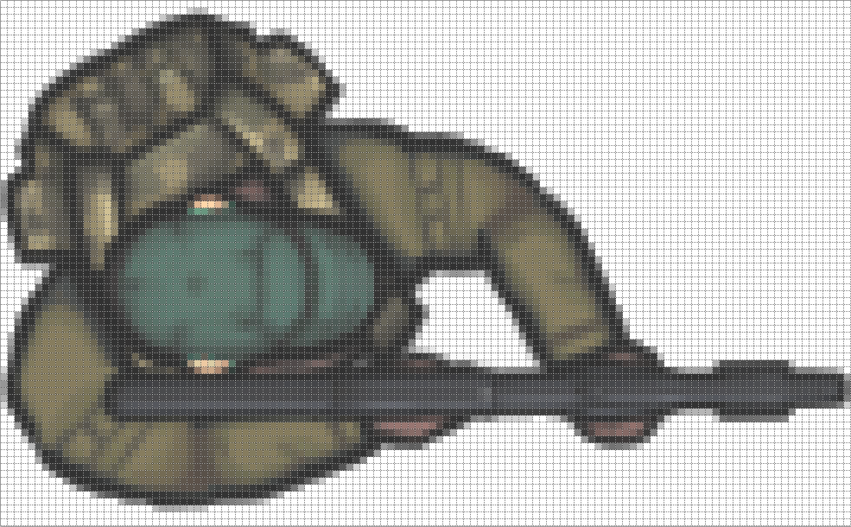
128
Center of Rotation
76
Gun Offset
Center
Offset
End of
Gun Barrel

Slide 2
Scanning
Player close or vulnerable
Waiting
event
Loading
Scanning
event
Alert event
Media loaded
Alert
Waiting
Player close or vulnerable
End wait
event
Playing
Waiting
Aim and Gun fire event
Frame event for last frame
Player or
guard dead
Reloading

Slide 3
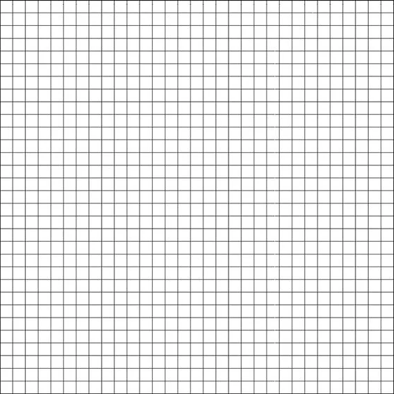

Z
Camera position
Y
X

Slide 4

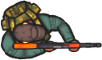
Z
Camera position
Y
X

Slide 5
Z
Camera position
Y
X

